Slide 1
Energy in a cell
Chapter 9

Slide 2
Energy
What changes take place as you run?
  Breathe heavier
  Increase heartrate
What is fatigue caused by?
  Lack of energy (food/oxygen)
Carbohydrate Loading

Slide 3
9.1 The Need for Energy
How do we get energy?
Sun
Plants
Energy

Slide 4
How do we use energy?
Energy- the ability to do work
  Moving ions and molecules across membranes
  Sleeping- heart pumping, body heat, brain activity

Slide 5
We need ATP to have energy.
ATP- adenosine triphosphate
  Food is broken down “bit by bit”
  Energy from food is not used all at once
  We would have to eat constantly without ATP

Slide 6
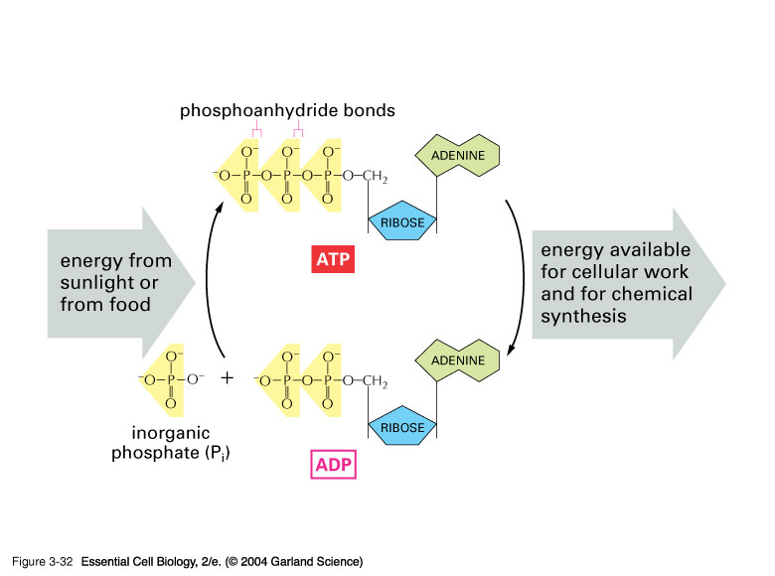

Slide 7
ATP
Forming and breaking down of ATP
Cells get energy by bonding a 3rd Phosphate to ADP (adenosine diphosphate)
ADP + P + Energy → ATP
ADP + P + Energy ← ATP
Low energy Higher energy

Slide 8
Uses of Cell Energy
Dehydration synthesis / Hydrolysis
Building membranes / Organelles
Maintain homeostasis
Cell reproduction

Slide 9
ATP vs. ADP
3 phosphates 2 phosphates
High Energy Low Energy
Both composed of Adenine and Ribose

Slide 10
9.2 Photosynthesis
6H₂O + 6CO₂ ----------> C₆H₁₂O₆+ 6O₂
Plants need water and carbon dioxide
Plants produce glucose and oxygen
Where does photosynthesis happen?
  Thylakoids of the chloroplast

Slide 11
Photosynthesis
Why is the chlorophyll green?
  Reflects green, absorbs all other colors
Why do leaves change color in the Fall?
  Chlorophyll dies
  Carotenes and Xanthophyll pigments present
  (red, orange, yellow)

Slide 12
Photosynthesis
“Photo”- Light reactions (in thylakoids)
  Photolysis- using light to split water
  H’s and O’s split
    Oxygen is given off
    Hydrogen is taken to the Calvin Cycle

Slide 13
Photosynthesis
“Synthesis”- Calvin Cycle (in Stroma)
  Hydrogen from light reactions combine with carbon dioxide to form sugars
  Six carbons will create a glucose molecule

Slide 14
Photosynthesis Summary
Sunlight provides energy to split water
Oxygen given off, Hydrogen taken from thylakoids to the stroma
Carbon Dioxide and hydrogen combine in a process called the Calvin Cycle to form glucose

Slide 15
Is Photosynthesis the source of all energy?
Chemosynthesis
  Energy from chemicals
  Methane-producing bacteria

Slide 16
9.3 Cellular Respiration
Getting ATP from our food
Where? Mitochondria
Carbohydrates, Protein, Fat
  Energy gained by breaking bonds

Slide 17
Relation to Photosynthesis
Photosynthesis
CO₂ + H₂O + light → C₆H₁₂O₆ + O₂
Cellular Respiration
C₆H₁₂O₆ + O₂ → CO₂ + H₂O + energy (ATP)

Slide 18
5 Tanks- What will happen?
Water, plant (in sunlight)
Water, plant, fish (in sunlight)
Water, fish (in sunlight)
Water, plant (in dark)
Water, plant, fish (in dark)

Slide 19
Types of Cellular Respiration
Aerobic Respiration
Breaking down food to create energy with oxygen present
Creates 38 ATP per glucose
Anaerobic Respiration
Breaking down food without oxygen present
Creates 2 ATP per glucose (does not completely breakdown)

Slide 20
Cellular Respiration
Glucose
Pyruvic Acid
Acetyl CoA
Krebs / Citric Acid Cycle
Electron Transport Chain

Slide 21
Fermentation- Anaerobic Resp.
Lactic Acid Fermentation (3-carbons)
  Pyvuvic Acid → Lactic Acid
  Fatigue, sore muscles, yogurt
Alcohol Fermentation (2-carbons)
  Pyruvic Acid → Ethyl Alcohol + CO₂
  Caused by yeast
  Alcohol and bread (gas release causes it to rise)

